Slide 1

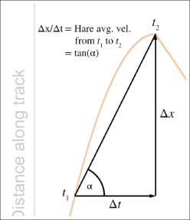
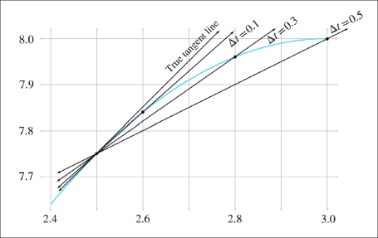
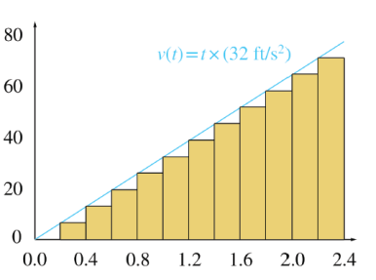
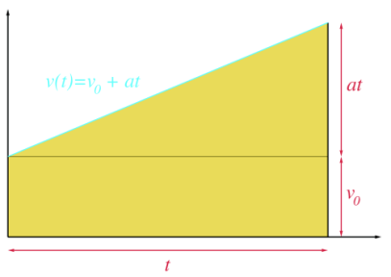
Chapter 11: Mechanics 1: Linear Kinematics & Calculus
Fletcher Dunn
Valve Software
Ian Parberry
University of North Texas
3D Math Primer for Graphics & Game Development

Slide 2
What You’ll See in This Chapter
This chapter gives a taste of linear kinematics and calculus. It is divided into eight sections.
Section 11.1 gives an overview of what we hope to achieve.
Section 11.2 talks about basic quantities and units.
Section 11.3 introduces average velocity.
Section 11.4 looks at instantaneous velocity and the derivative.
Section 11.5 is about acceleration.
Section 11.6 discusses motion under constant acceleration.
Section 11.7 looks at acceleration and the integral.
Section 11.8 examines uniform circular motion.

Slide 3
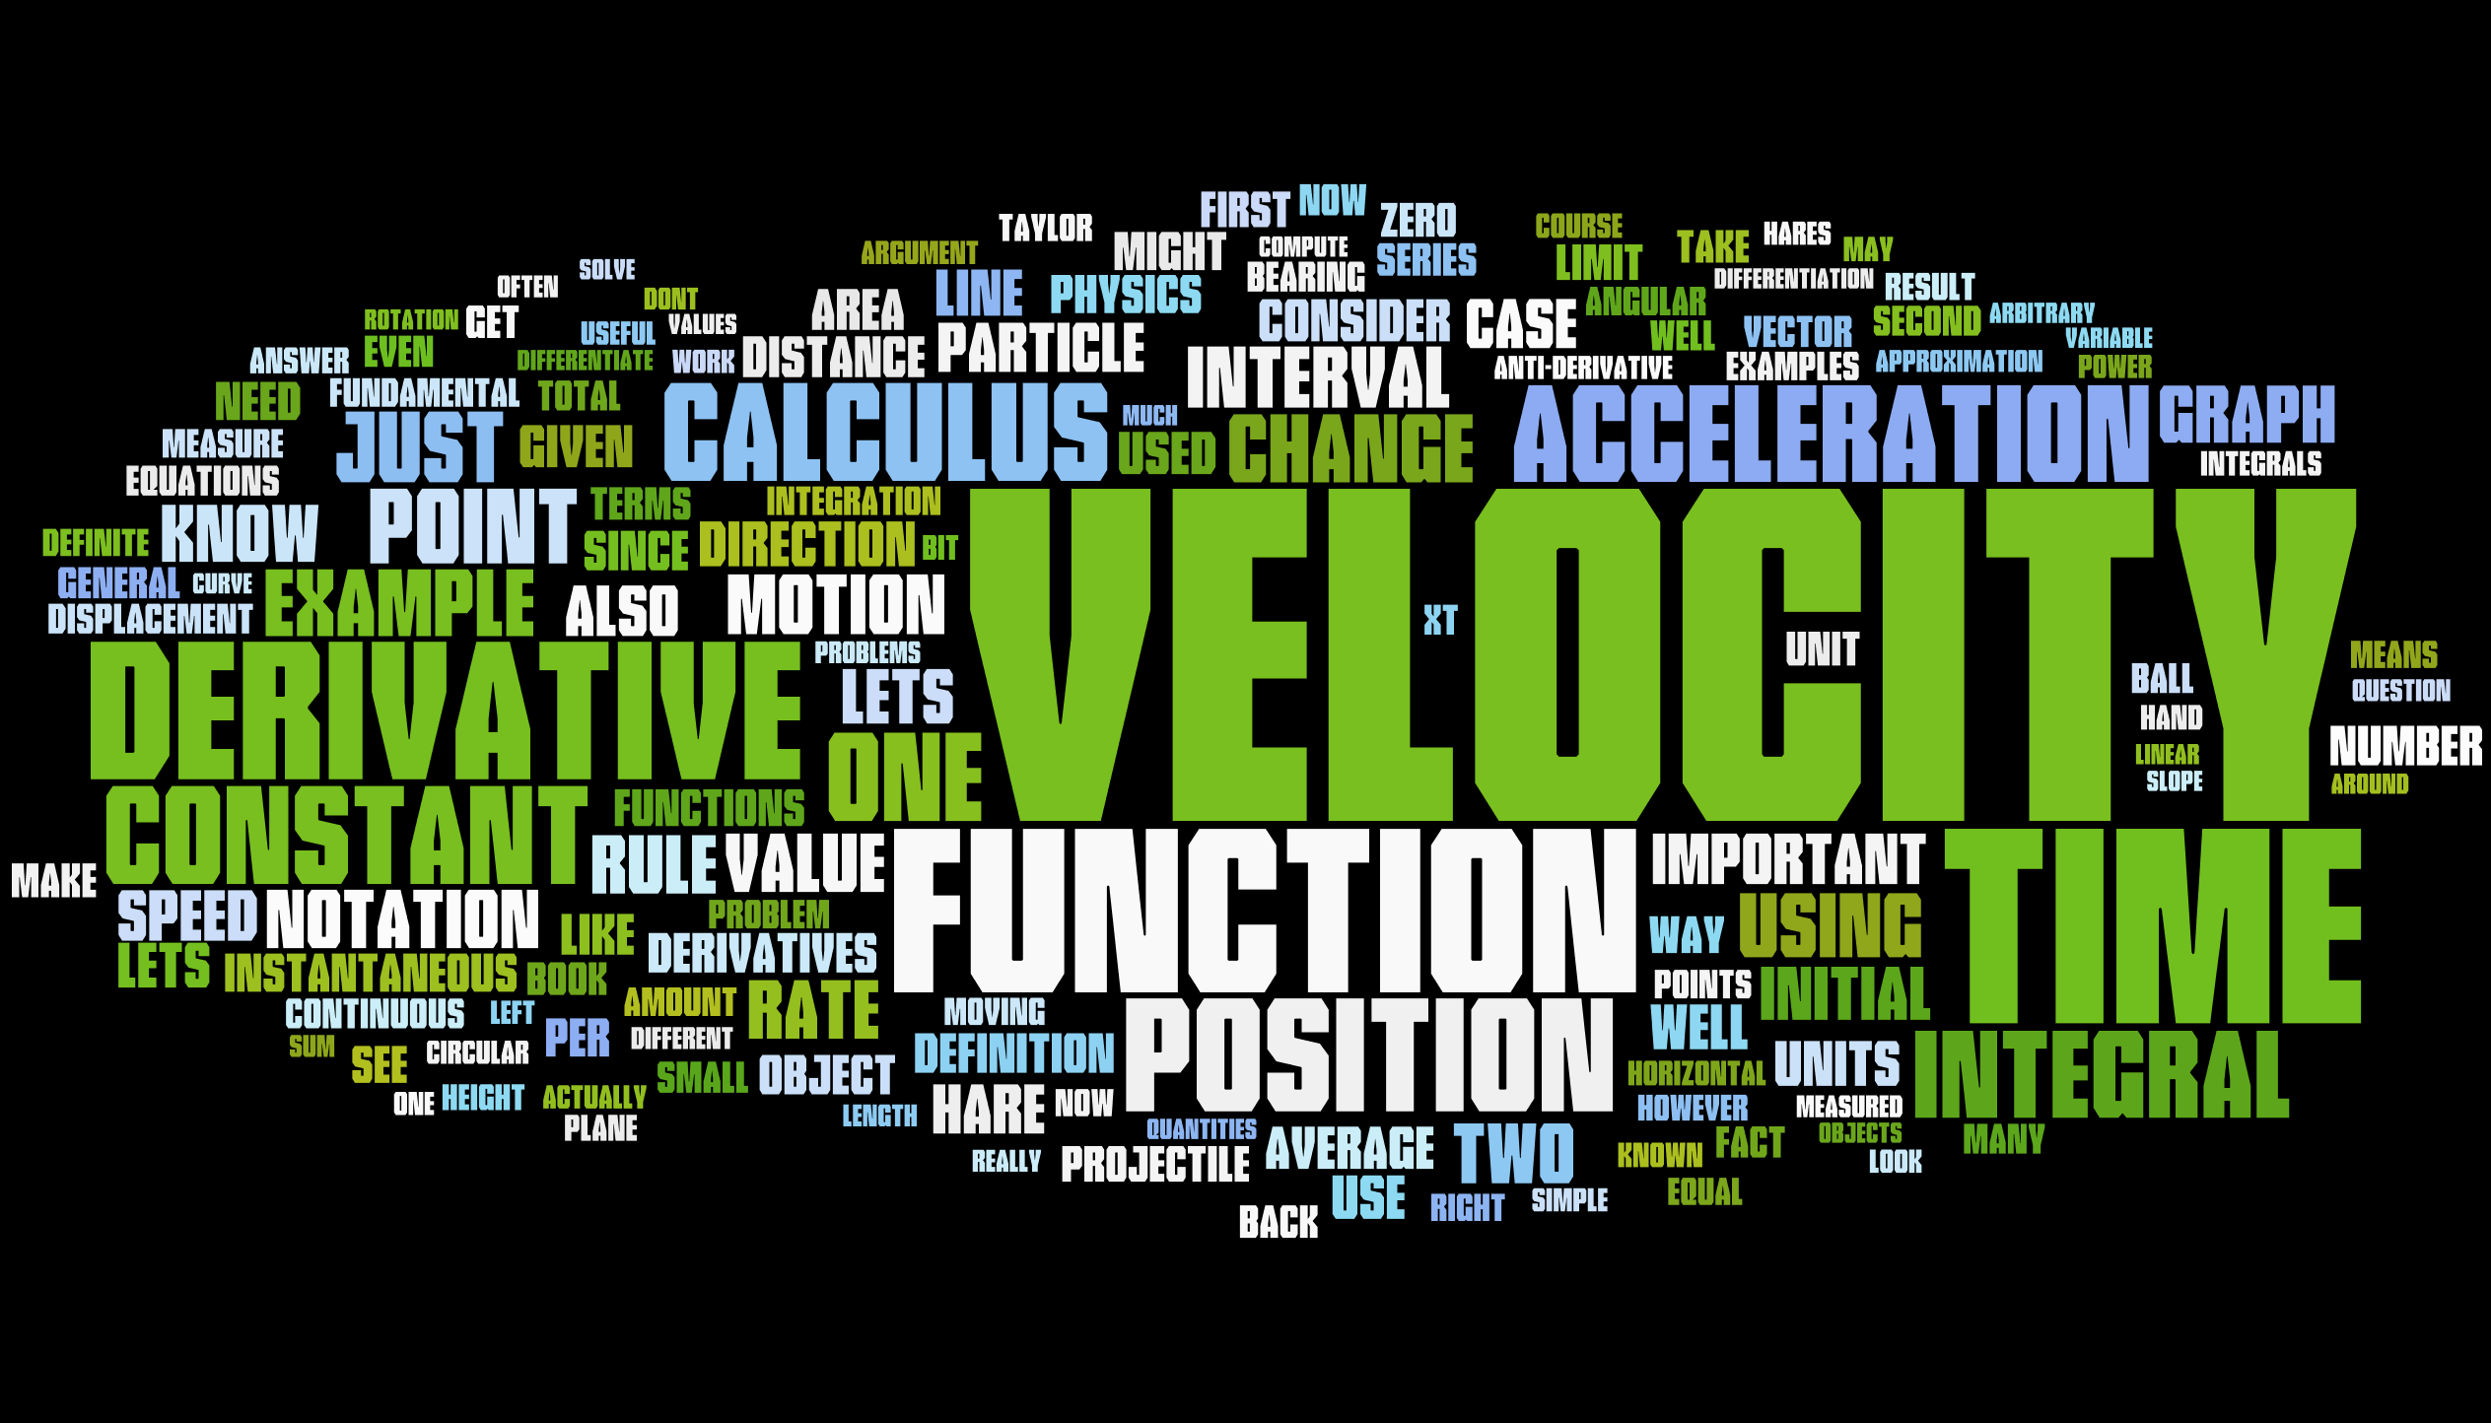
Word Cloud

Slide 4
Section 11.1: Overview

Slide 5
A Modest Proposal
After reading this chapter, you should know:
The basic idea of what a derivative measures and what it is used for.
The basic idea of what an integral measures and what it is used for.
Derivatives and integrals of trivial expressions containing polynomials and trig functions.

Slide 6
How Much Calculus is Needed?
I know absolutely nothing about derivatives or integrals.
I know the basic idea of derivatives or integrals, but probably couldn't solve any freshman calculus problems with a pencil and paper.
I have studied some calculus.
Level 2 knowledge of calculus is sufficient for this book, and our goal is to move everybody who is currently in category 1 into category 2. If you're in category 3, our calculus discussions will be a (hopefully entertaining) review. We have no delusions that we can move anyone into category 3 who is not already there.

Slide 7
Doublethink About Discreteness & Continuity
There is strong evidence that the Universe (the real one) is discrete in both time and space.
Continuous approximation of the Universe is a harmless but useful delusion.
It is useful because continuous mathematics is, in general, easier than discrete mathematics.
Computers do discrete math, so we will be using a discrete approximation of a continuous approximation of the discrete Universe.
However, we can do as we damn well please in our virtual worlds provided they are real enough to trigger willing suspension of disbelief long enough to play a game.

Slide 8
Classical Mechanics
We are going to study classical mechanics, also known as Newtonian mechanics, which has several simplifying assumptions that are incorrect in general but true in everyday life in most ways that really matter to us:
Time is absolute
Space is Euclidian
Precise measurements are possible
The universe exhibits causality and complete predictability
The first two are shattered by relativity, the second two by quantum mechanics. Thankfully, these two subjects are not necessary for video games.

Slide 9
Particles and Dimensions
We aim, in this chapter, to do the math to get equations that predict the position, velocity, and acceleration of a particle at any given time t.
Because we are treating our objects as particles, we will not consider their orientation or rotational effects until Chapter 12.
When rotation is ignored, all of the ideas of linear kinematics extend into 3D in a straightforward way, and so for now we will be limiting ourselves to 2D (and 1D).

Slide 10
Section 11.2: Basic Quantities and Units

Slide 11
Length, Time, and Mass
Mechanics is concerned with the relationship among three fundamental quantities in nature: length, time, and mass.
Length is a quantity you are no doubt familiar with. We measure length using units like centimeters, inches, meters, and feet.
Time is another quantity we are very comfortable with measuring. We measure time using units like second, minute, and hour.
The quantity mass is not quite as intuitive as length and time. The measurement of an object's mass is often thought of as measuring the “amount of stuff” in the object.
This is not a bad definition, but it’s not quite right.

Slide 12
Mass and Weight
Mass is often confused with weight, especially since the units used to measure mass are also used to measure weight: the gram, pound, kilogram, ton, etc.
The mass of an object is an intrinsic property, while its weight is a local phenomenon that depends on the strength of the gravitational pull exerted by a nearby massive object.
Your mass will be the same whether you are in Chicago, or on the moon, or near Jupiter, or light years away from the nearest heavenly body, but in each case your weight will be very different.
In this book and in most video games our concerns are confined to a relatively small patch on a flat Earth, and we will approximate gravity by a constant downward pull.
It won't be too harmful to confuse mass and weight because gravity for us will be a constant.

Slide 13
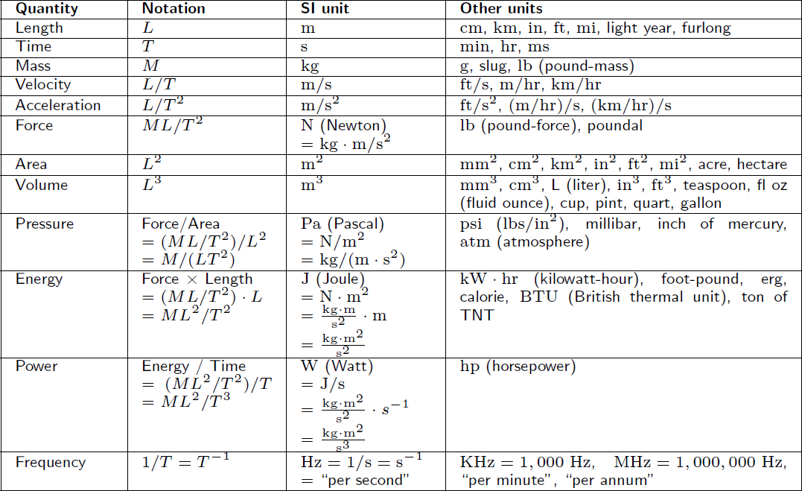

Slide 14
Section 11.3: Average Velocity

Slide 15
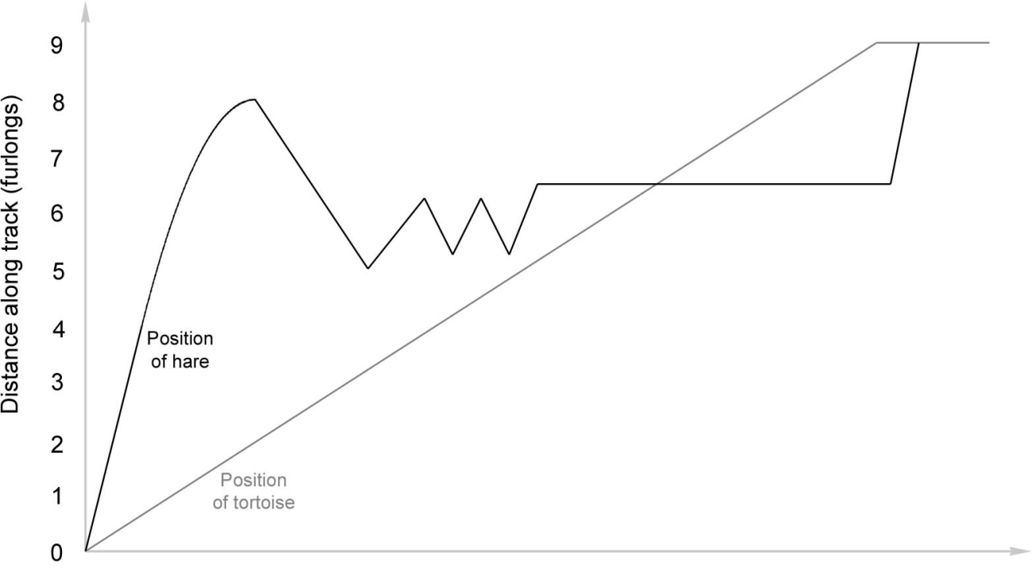
Story of the Tortoise & the Hare (Math Version)
Once upon a time there was a tortoise and a hare.
The average velocity of the tortoise is greater than the average velocity of the hare.
The End.

Slide 16




The Tortoise and the Hare
The gun goes off at time t₀.
The hare sprints ahead to time t₁, then slows.
At time t₂ a distraction passes by in the opposite direction. The hare turns around and walks with her.
At time t₃ he gives up on her and begins to pace back and forth along the track dejectedly until time t₄, when he takes a nap.
Meanwhile the tortoise has been making slow and steady progress, and at time t₅ he catches up with the sleeping hare.
The tortoise plods along and crosses the tape at t₆.
The hare wakes up at time t₇ and hurries in a frenzy to the finish.
At time t₈ the hare crosses the finish line.

Slide 17
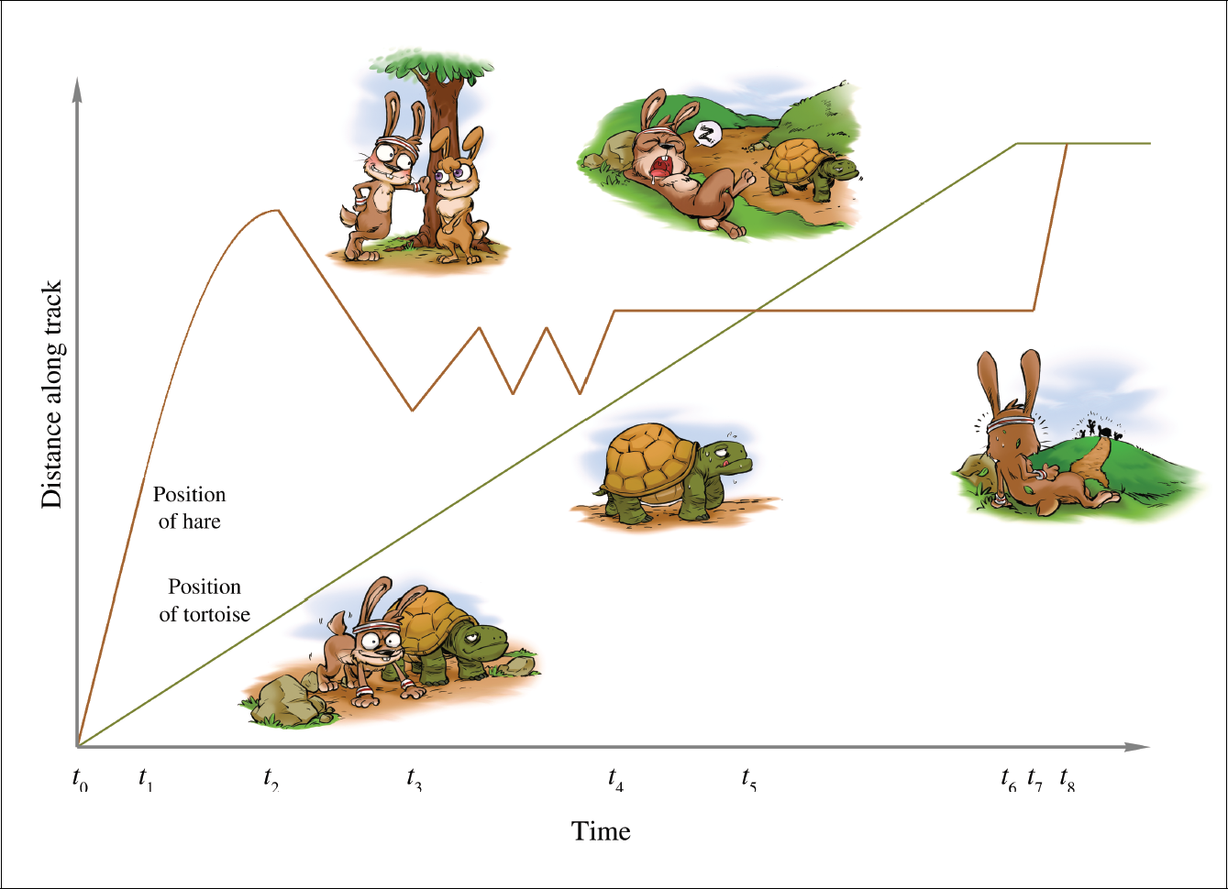

Slide 18
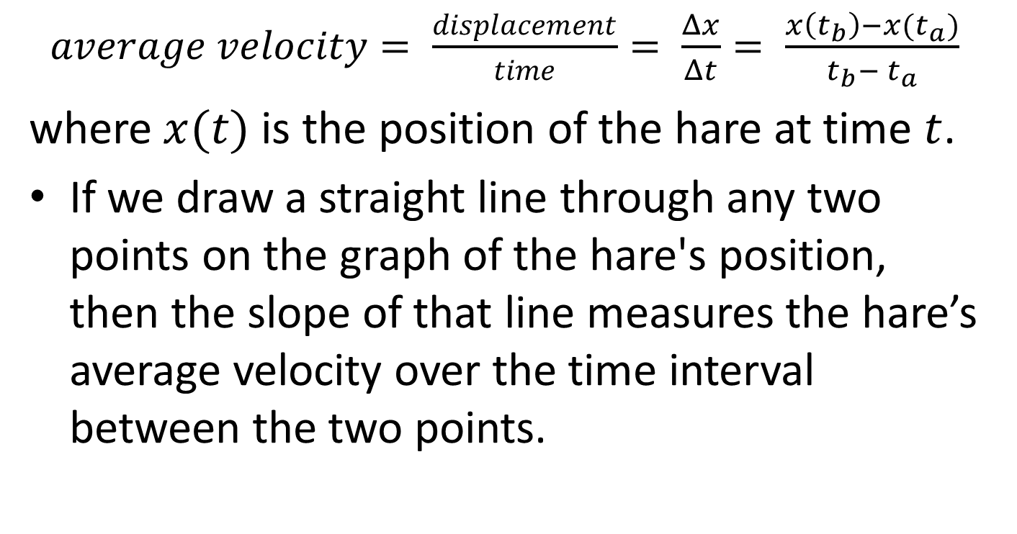
Average Velocity
$average velocity= \frac{displacement}{time}= \frac{Δx}{Δt}= \frac{x\left(t_{b}\right)−x(t_{a})}{t_{b}− t_{a}}$
where $x(t)$ is the position of the hare at time $t$.
If we draw a straight line through any two points on the graph of the hare's position, then the slope of that line measures the hare’s average velocity over the time interval between the two points.

Slide 19

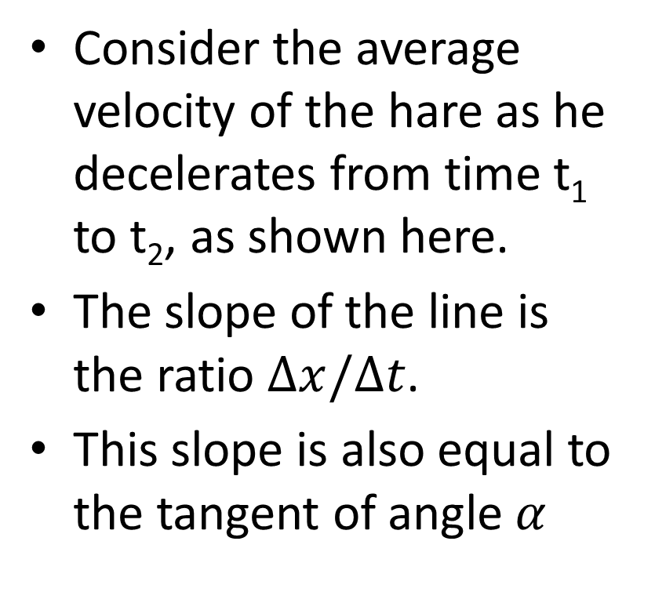
Example
Consider the average velocity of the hare as he decelerates from time t₁ to t₂, as shown here.
The slope of the line is the ratio $Δx/Δt$.
This slope is also equal to the tangent of angle $α$

Slide 20
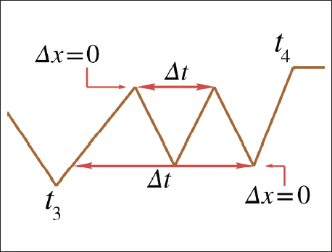

Sign of Average Velocity
Average velocity can even be negative or 0.
It is zero when $Δx=0$.

Slide 21
Section 11.4: Instantaneous Velocity & the Derivative

Slide 22
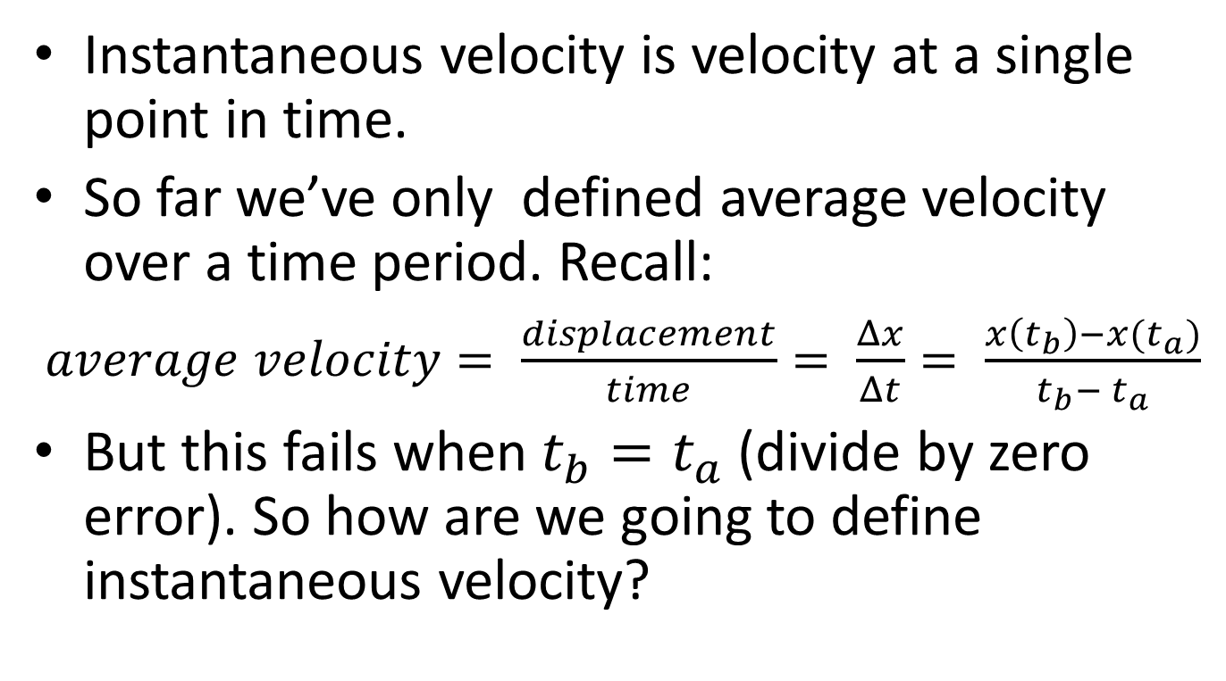
What is Instantaneous Velocity?
Instantaneous velocity is velocity at a single point in time.
So far we’ve only defined average velocity over a time period. Recall:
$average velocity= \frac{displacement}{time}= \frac{Δx}{Δt}= \frac{x\left(t_{b}\right)−x(t_{a})}{t_{b}− t_{a}}$
But this fails when $t_{b}=t_{a}$(divide by zero error). So how are we going to define instantaneous velocity?

Slide 23
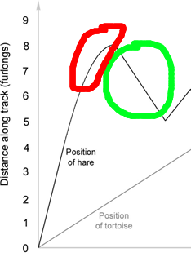
An Easy Case
Instantaneous velocity is easy when velocity is a constant for a nonzero period of time.
The velocity graph will be a straight line.
The hard part is when velocity is changing.
The velocity graph will not be a straight line.

Slide 24
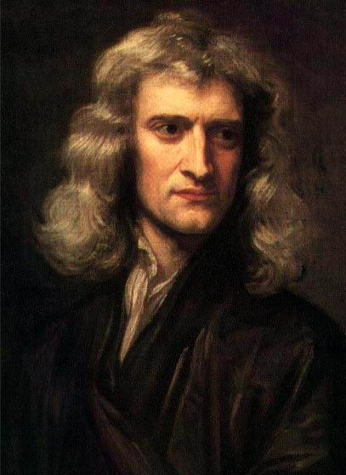
Sir Isaac Newton to the Rescue
Image: Wikimedia Commons

Slide 25
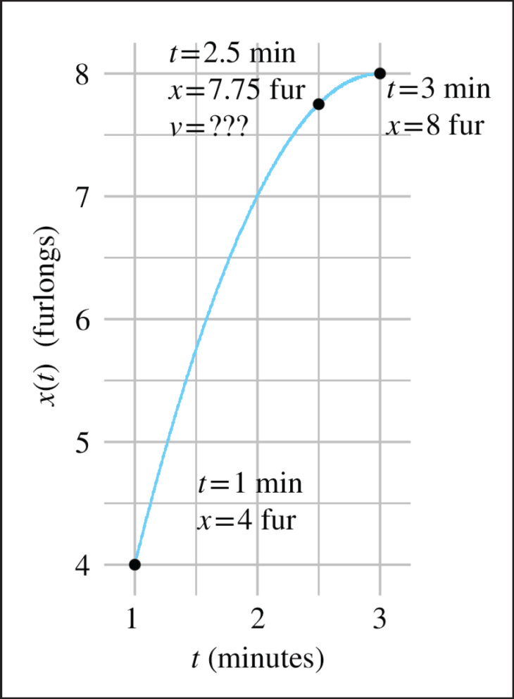
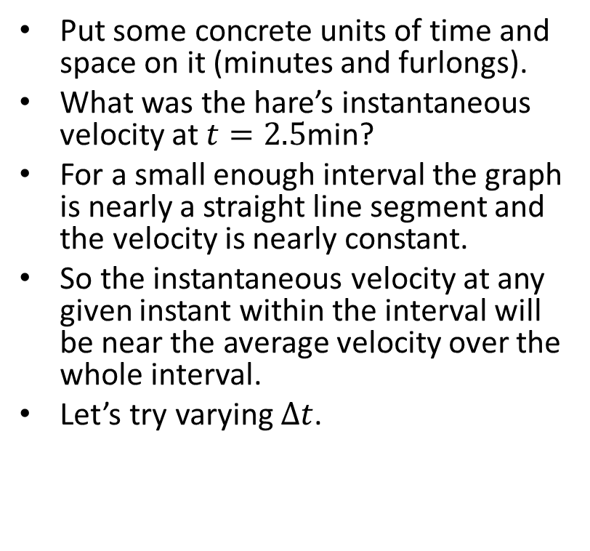
Here We Go
Put some concrete units of time and space on it (minutes and furlongs).
What was the hare’s instantaneous velocity at $t=2.5$min?
For a small enough interval the graph is nearly a straight line segment and the velocity is nearly constant.
So the instantaneous velocity at any given instant within the interval will be near the average velocity over the whole interval.
Let’s try varying $Δt$.

Slide 26
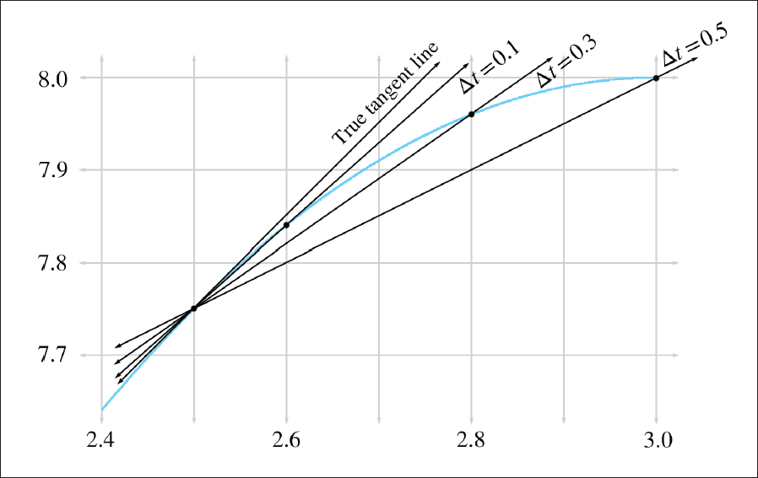

Slide 27
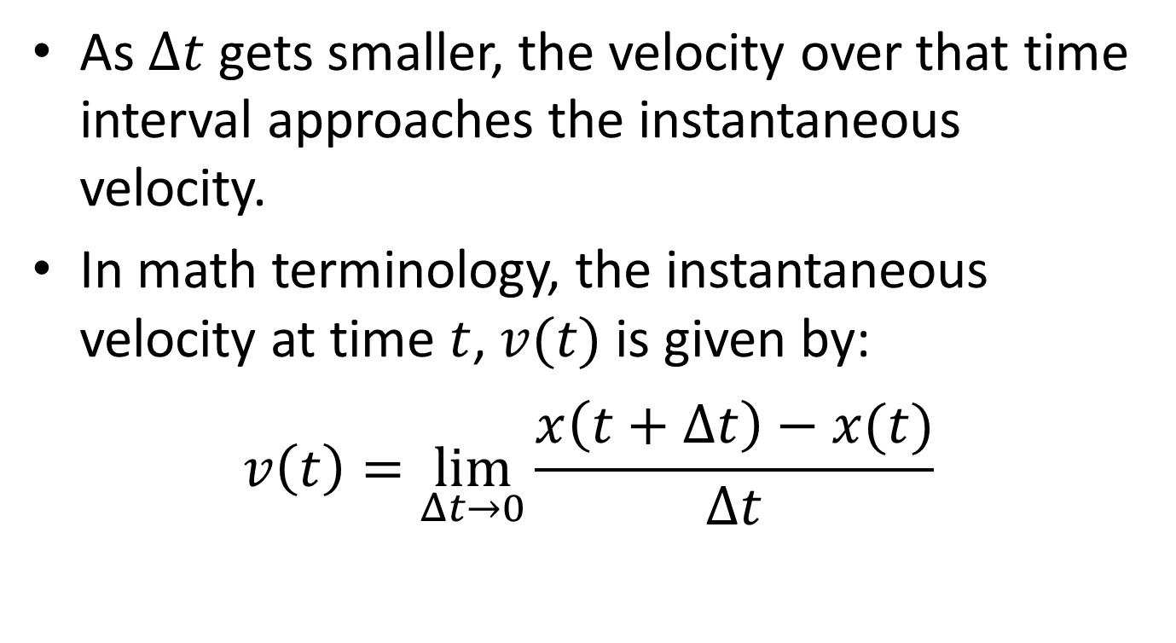
Limits
As $Δt$ gets smaller, the velocity over that time interval approaches the instantaneous velocity.
In math terminology, the instantaneous velocity at time $t$, $v(t)$ is given by:
$$v\left(t\right)=\lim_{Δt→0}{\frac{x\left(t+Δt\right)−x(t)}{Δt} }$$

Slide 28
Calculus
Hopefully you’ve taken Freshman Calculus.
If not, there’s a summary in the book (Sections 11.4.2 to 11.4.7).
11.4.2: Examples of Derivatives
11.4.3: Calculating Derivatives from the Definition
11.4.4: Notation
11.4.5: A Few Rules and Shortcuts
11.4.6: Derivatives with Taylor Series
11.4.7: The Chain Rule

Slide 29
Section 11.5: Acceleration

Slide 30
What is Acceleration?
Acceleration is rate of change of velocity.
Acceleration is a vector.
For example, the acceleration due to gravity is about 32 ft/s², equivalently 9.8 m/s² downwards.
The velocity at an arbitrary time t of an object under constant acceleration a is given by the simple linear formula v(t) = v₀ + at, where v₀ is the initial velocity at time t = 0.

Slide 31
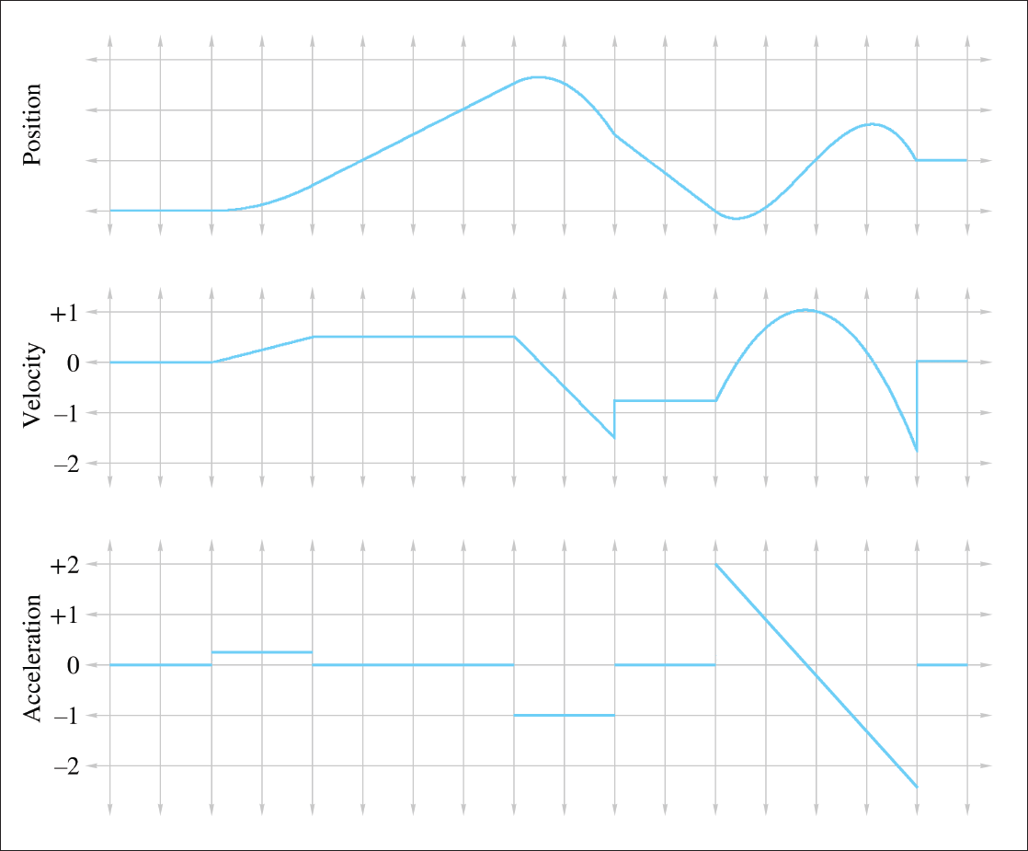

Slide 32
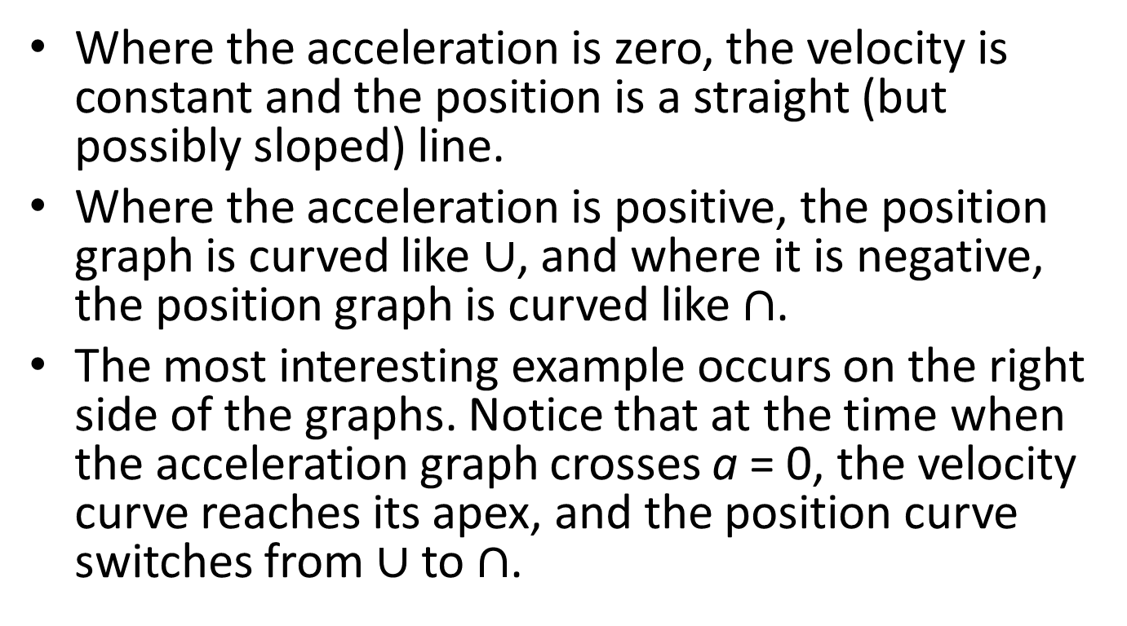
Observations
Where the acceleration is zero, the velocity is constant and the position is a straight (but possibly sloped) line.
Where the acceleration is positive, the position graph is curved like $∪$, and where it is negative, the position graph is curved like $∩$.
The most interesting example occurs on the right side of the graphs. Notice that at the time when the acceleration graph crosses a = 0, the velocity curve reaches its apex, and the position curve switches from $∪$to $∩$.

Slide 33
More Observations
A discontinuity in the velocity function causes a kink in the position graph. Furthermore, it causes the acceleration to become infinite (actually, undefined). Such discontinuities don't happen in the real world.
This is why the lines in the velocity graph are connected at those discontinuities, because the graph is of a physical situation being approximated by a mathematical model.
A discontinuity in the acceleration graph causes a kink in the velocity graph, but notice that the position graph is still smooth. In fact, acceleration can change instantaneously, and for this reason we have chosen not to bridge the discontinuities in the acceleration graph.

Slide 34
Section 11.6: Motion Under Constant Acceleration

Slide 35
Motion Under Zero Acceleration
Position under zero acceleration is given by x(t) = x₀ + vt, where x₀ is the initial position at time t = 0, and v is the constant velocity.
This is also the parametric definition of a ray.

Slide 36
Projectile Motion
Projectile motion is acceleration under gravity.
For simplicity, we ignore wind resistance.
Out goal is a function x(t) for the position of a projectile at time t.
It’s confusing, but we’re going to use x for vertical distance here.

Slide 37
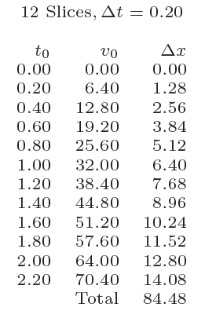
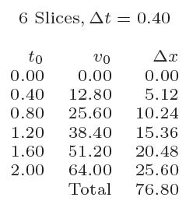
Numerical Approximation

Slide 38
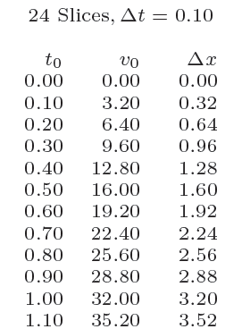
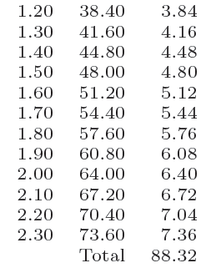
Numerical Approximation 2

Slide 39
Convergence
The approximations get better as the number of time slices increase.
We say that it converges to the correct value.
Acceleration is the area under the velocity graph.
We get a better approximation as the number of slices increases.

Slide 40
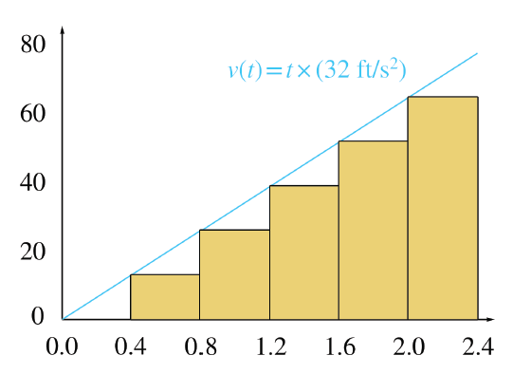

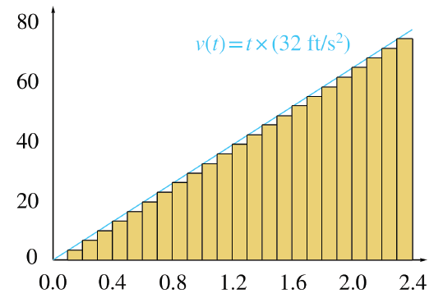
Area Under the Velocity Graph

Slide 41

Example
Question: How far will an object thrown downwards from the top of a tall building at 5 ft/sec travel in 2.4 seconds?
Answer: The area under v(t) from t=0 to t=2.4.

Slide 42
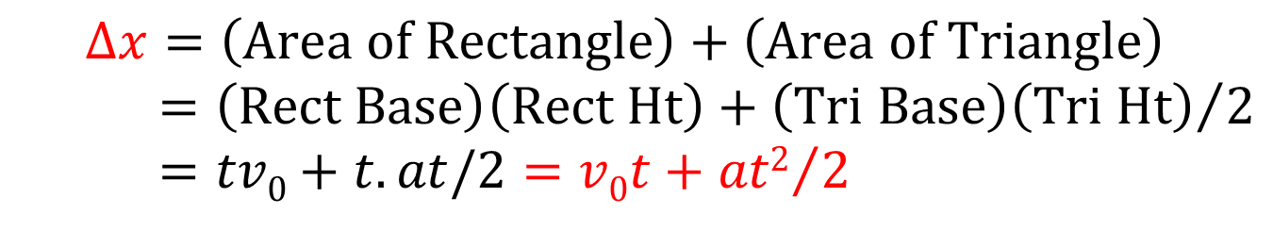
Remember This Formula
$$Δx=\left(\text{Area} \text{of} \text{Rectangle}\right)+\left(\text{Area} \text{of} \text{Triangle}\right)=\left(\text{Rec}\text{t} \text{Base}\right)\left(\text{Rect} \text{Ht}\right)+{\left(\text{Tri} \text{Base}\right)\left(\text{Tri} \text{Ht}\right)}/2=tv0+t. at/2=v0t+{at2}/2$$

Slide 43

So the Answer Is…
$$Δx=v0t+{at2}/2=5⋅2.4+32⋅{2.42}/2=12+256=268\text{ft}$$

Slide 44
Section 11.7: The Integral

Slide 45
Section 11.8: Uniform Circular Motion

Slide 46
That concludes Chapter 11. Next, Chapter 12: Mechanics 2: Linear & Rotational Dynamics

